Slide 1
Microservices and DevOps
Scalable Microservices
Quality Attributes ala Bass et al.
Henrik Bærbak Christensen

Slide 2
Motivation
Why is software architecture interesting ???
It is not interesting from a functionality point of view!
  Almost any user requirement can be achieved by any architecture you like, including the ‘one-big-ball-of-mud’ !
Architecture is essential to achieve quality attributes
  Performance, maintainability, security, availability, testability, …
So – a short side-step into my ‘SAiP’ fagpakke…

Slide 3

Bass et al.
Proposes uniform measurement template
  Quality Attribute Scenarios
  Key point: Same template for radically different qualities, like performance or security
Anchors quality in specific context
  Quality Attribute Scenarios
  No quality is globally achievable

Slide 4
Quality framework (Bass et al.)
Quality attributes
  Availability
  Interoperability
  Modifiability
  Performance
  Security
  Testability
  Usability
Other Quality attributes
  Variability
  Portability
  Dev Distributability
  Scalability
  Deployability
  Mobility
  Monitorability
  Safety
Conceptual Integrity

Slide 5
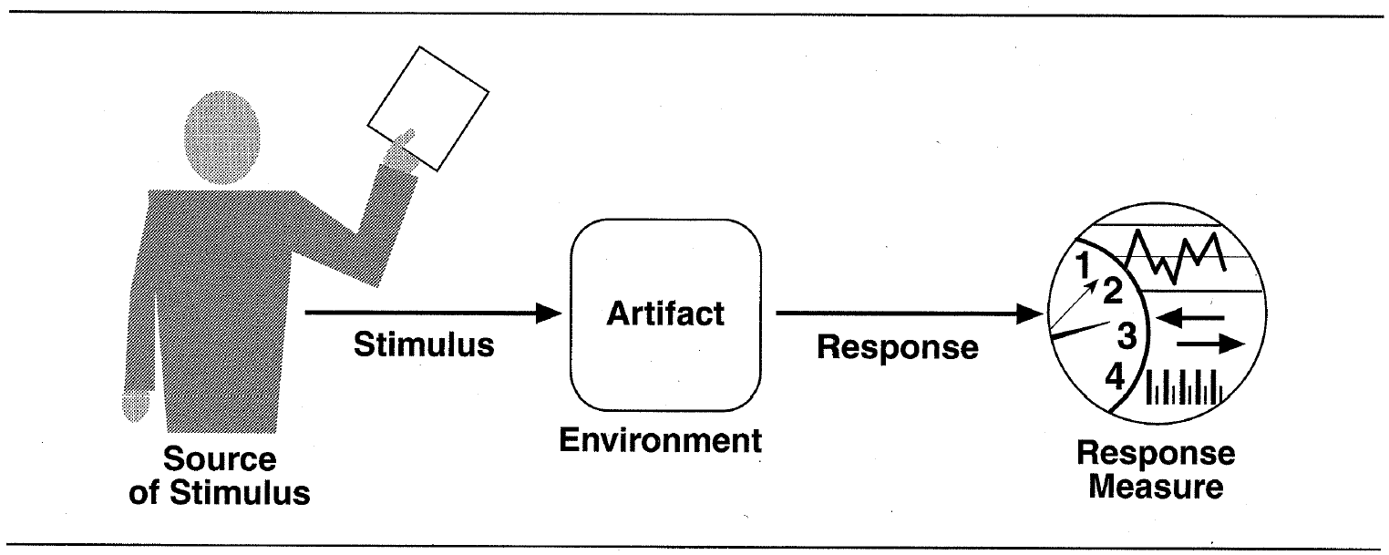
A writing template
Source of stimulus. This is some entity (a human, a computer system, or any other actuator) that generated the stimulus.
Stimulus. The stimulus is a condition that needs to be considered when it arrives at a system.
Environment. The stimulus occurs within certain conditions. The system may be in an overload condition or may be running when the stimulus occurs, or some other condition may be true.
Artifact. Some artifact is stimulated. This may be the whole system or some pieces of it.
Response. The response is the activity undertaken after the arrival of the stimulus.
Response measure. When the response occurs, it should be measurable in some fashion so that the requirement can be tested.

Slide 6
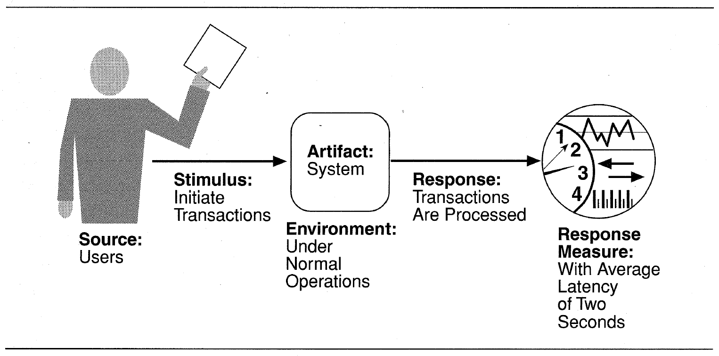
Example: Performance

Slide 7
Selected QA
The Microservice style has specific
QA focus…

Slide 8
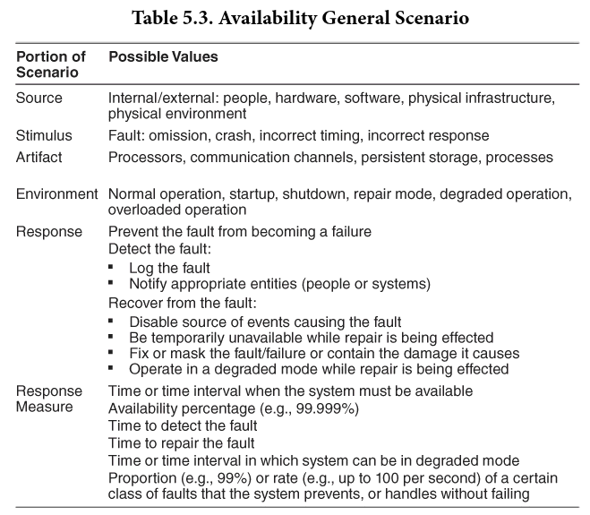
Availability
Concerned with the probability that the system will be operational when needed

Slide 9
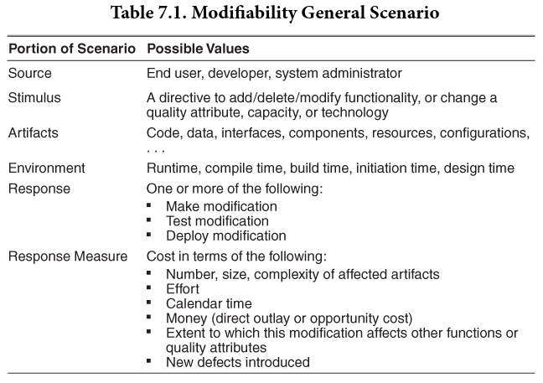
Modifiability
Concerned with the ease with which the system supports change

Slide 10
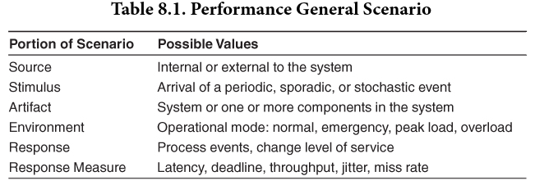
Performance
Concerned with ability to meet timing requirements

Slide 11
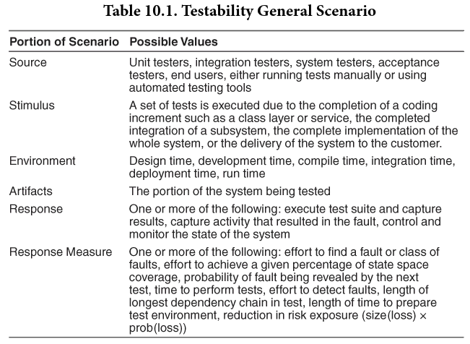
Testability
Concerned with the ease with which the software can be made to demonstrate its faults

Slide 12
SkyCave Examples

Slide 13
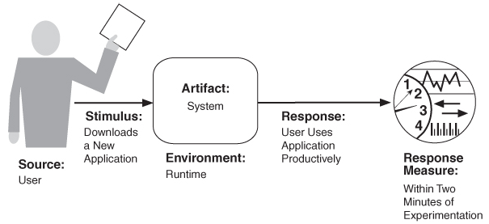
QAS
QAS capture architectural quality attribute requirements in a common format
  Some source generates some events (stimuli) that arrives at some artefact under some conditions (environment) and must be dealt with (response) in a satisfactory way (response measure = the architectural requirement)
The response measure is central – measurable!

Slide 14
Example QAS
Modifiabilty Quality
Customer (source) wants to switch to MongoDB stimulus) in the storage engine (artifact) at development time (environment). The modifications are developed, tested, and delivered with no sideeffects (response) within 8 staff hours (response measure).
Exercise:
  Does the SkyCave architecture fulfill this QAS?
  Why/why not?

Slide 15
Example QAS
Performance Quality
10.000 players generate two stochastic events pr second on the daemon in normal operations. All events are processed with 95% quartile response time of max 50 ms.
Exercise:
  Does the SkyCave architecture fulfill this QAS?
  Why/why not?

Slide 16
Summary
The Microservice Architectural style is in my opinion a style that strives for
  Modifiability (low coupling, high cohesion)
  Availability (design for failure)
  Performance (horizontal and independent scaling)
  Testability (continuous deployment, pipelines)
Which – are concisely formulated using QAS
  Because it emphasize the response measure, meaning we talk in terms of numbers, much more than just ‘better/faster/more’…
Not required to use in this course, but… ☺

